Slide 1





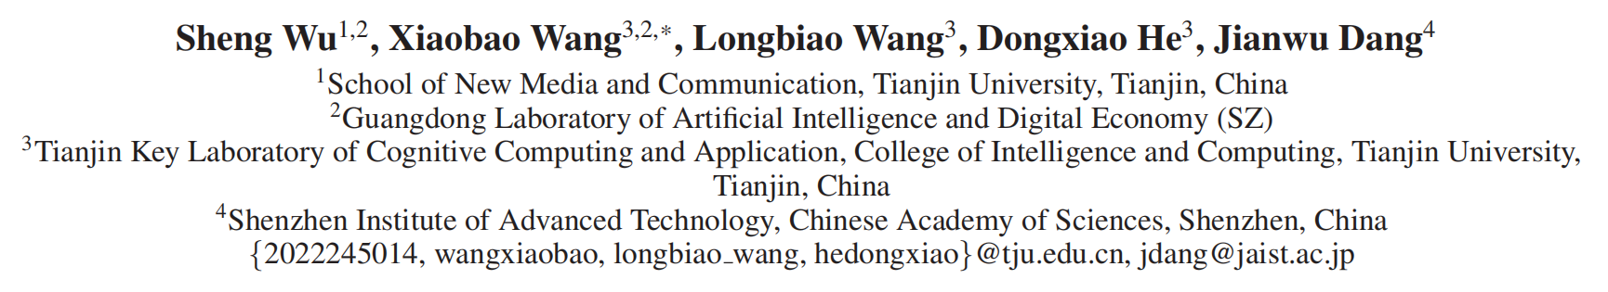





ATAI
Advanced Techniqueof Artificial Intelligence
ATAI
ChongqingUniversity _{AdvancedTechniqueof}
of Technology Artificial Intelligence
Chongqing University of
Technology
Chongqing University ^{ATAI}
_{of Technology} Advanced Techniqueof
Artificial Intelligence
Chongqing University of Technology
Chongqing University of Technology
Enriching Multimodal Sentiment Analysis through Textual Emotional Descriptions of Visual-Audio Content
Code:None
2025.1.16 •ChongQing
—— AAAI 2025
Reported by YaoChen Li
1

Slide 2

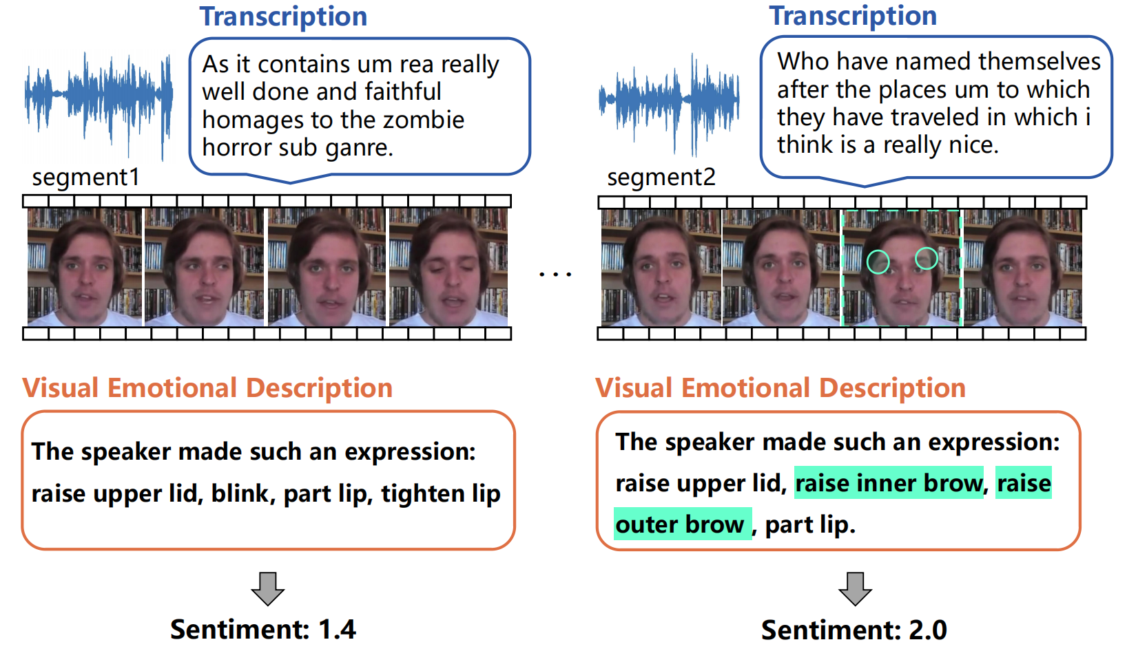
ATAI
AdvancedTechniqueof
Artificial Intelligence
ATAI
ChongqingUniversity _{AdvancedTechniqueof}
of Technology Artificial Intelligence
ChongqingUniversity of Technology
Motivation
(1)Discerning subtle differences in emotional intensity becomes challenging when the emotional polarities of different segments are closely aligned, particularly when analyzing raw data such as audio and visual inputs.

Slide 3

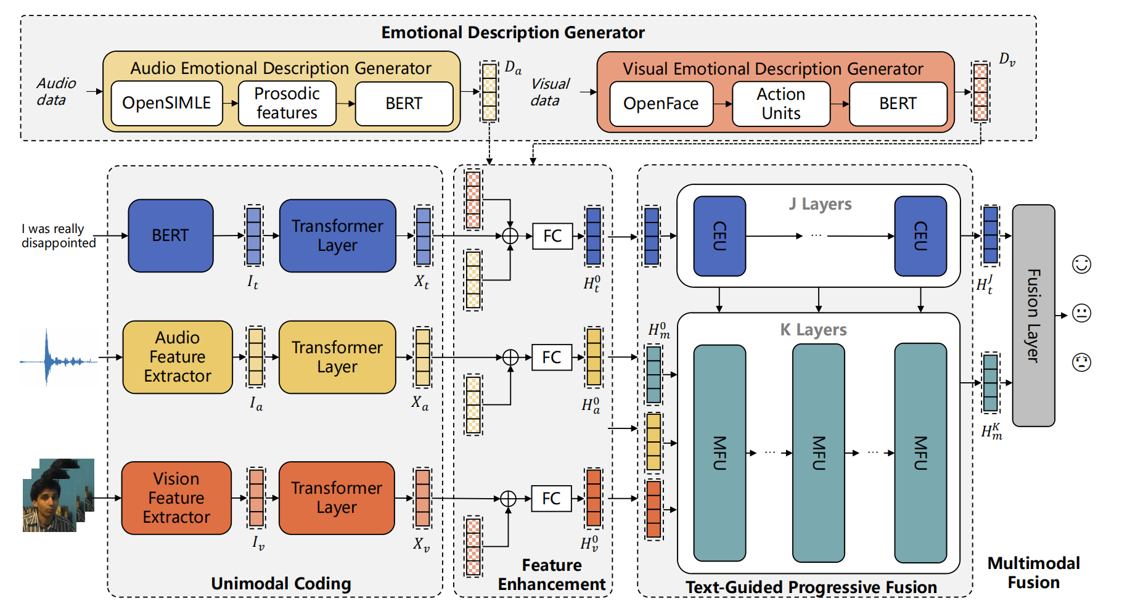
ChongqingUniversity of Technology
ATAI
AdvancedTechniqueof
Artificial Intelligence
ATAI
ChongqingUniversity _{AdvancedTechniqueof}
of Technology Artificial Intelligence
Overview

Slide 4
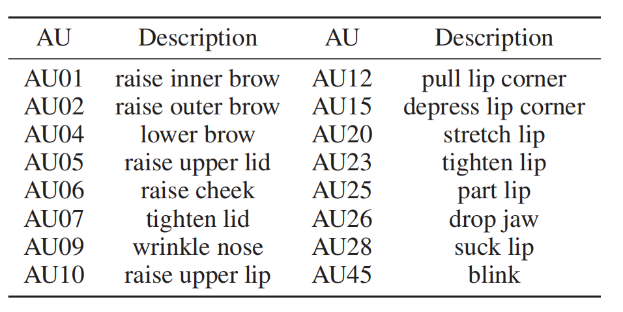
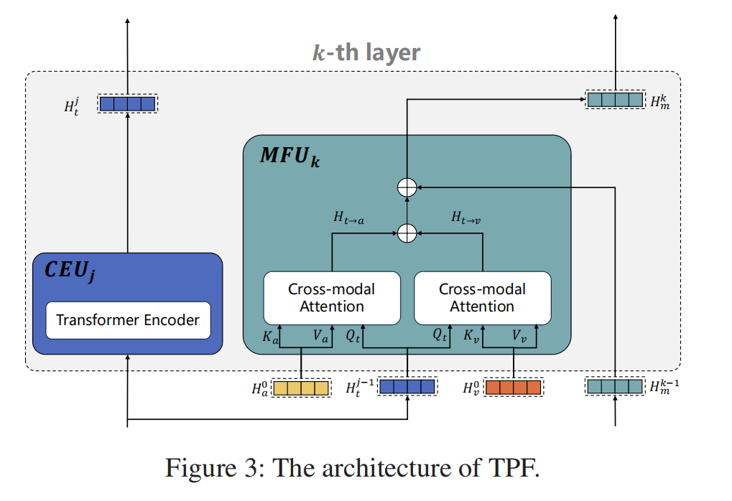
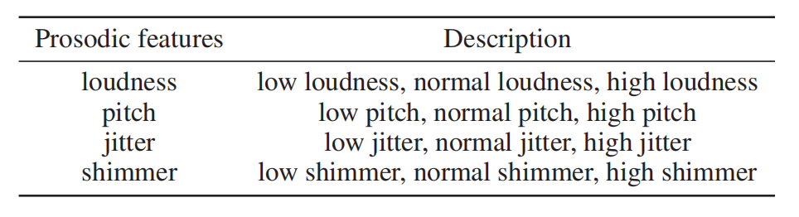
ChongqingUniversity of Technology
ATAI
AdvancedTechniqueof
Artificial Intelligence
ATAI
ChongqingUniversity _{AdvancedTechniqueof}
of Technology Artificial Intelligence
Overview

Slide 5

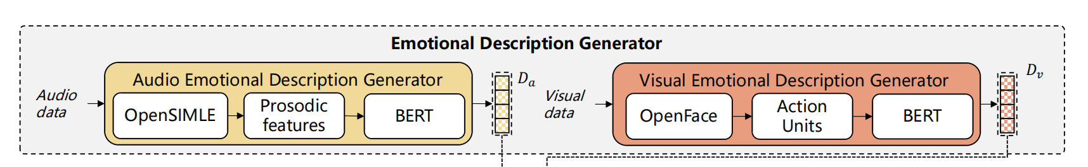
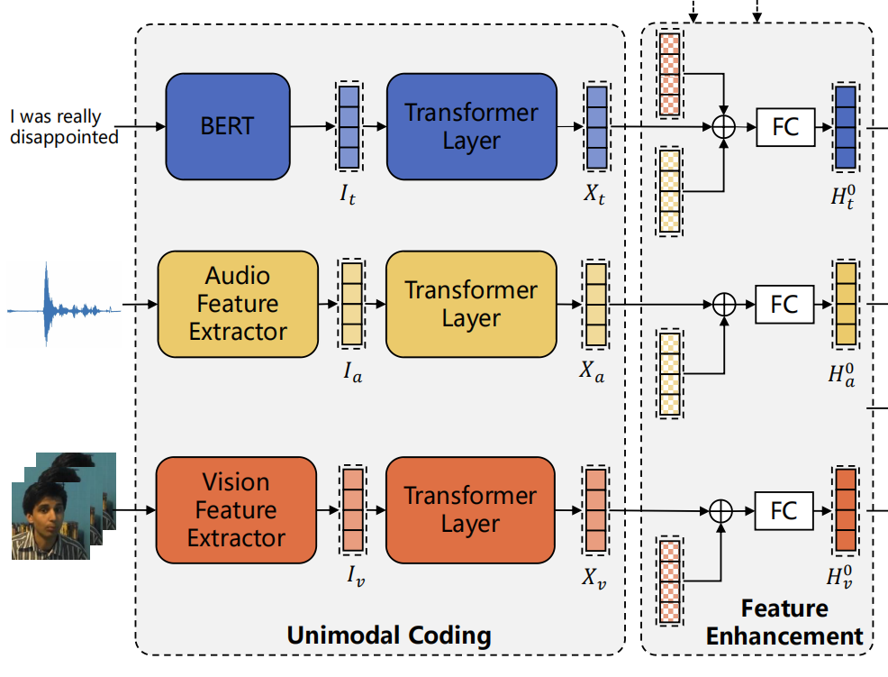

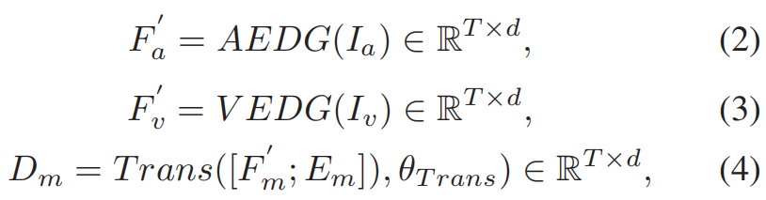



ChongqingUniversity of Technology
ATAI
AdvancedTechniqueof
Artificial Intelligence
ATAI
ChongqingUniversity _{AdvancedTechniqueof}
of Technology Artificial Intelligence
Method

Slide 6
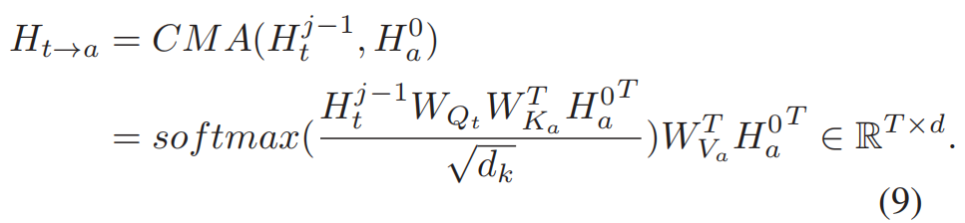
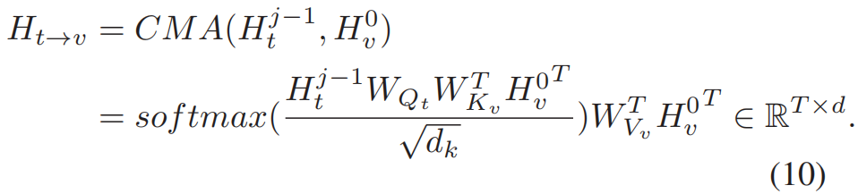

ChongqingUniversity of Technology
ATAI
AdvancedTechniqueof
Artificial Intelligence
ATAI
ChongqingUniversity _{AdvancedTechniqueof}
of Technology Artificial Intelligence
Method

Slide 7
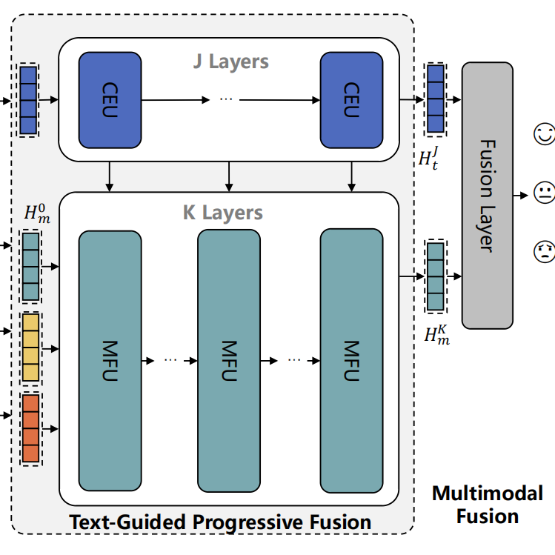
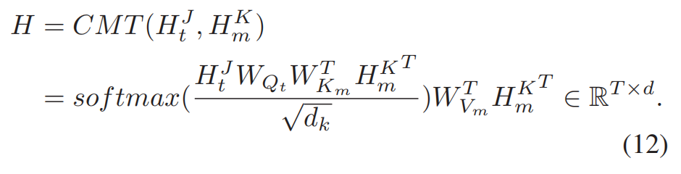
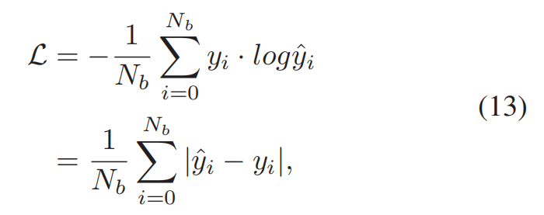
ChongqingUniversity of Technology
ATAI
AdvancedTechniqueof
Artificial Intelligence
ATAI
ChongqingUniversity _{AdvancedTechniqueof}
of Technology Artificial Intelligence
Method

Slide 8

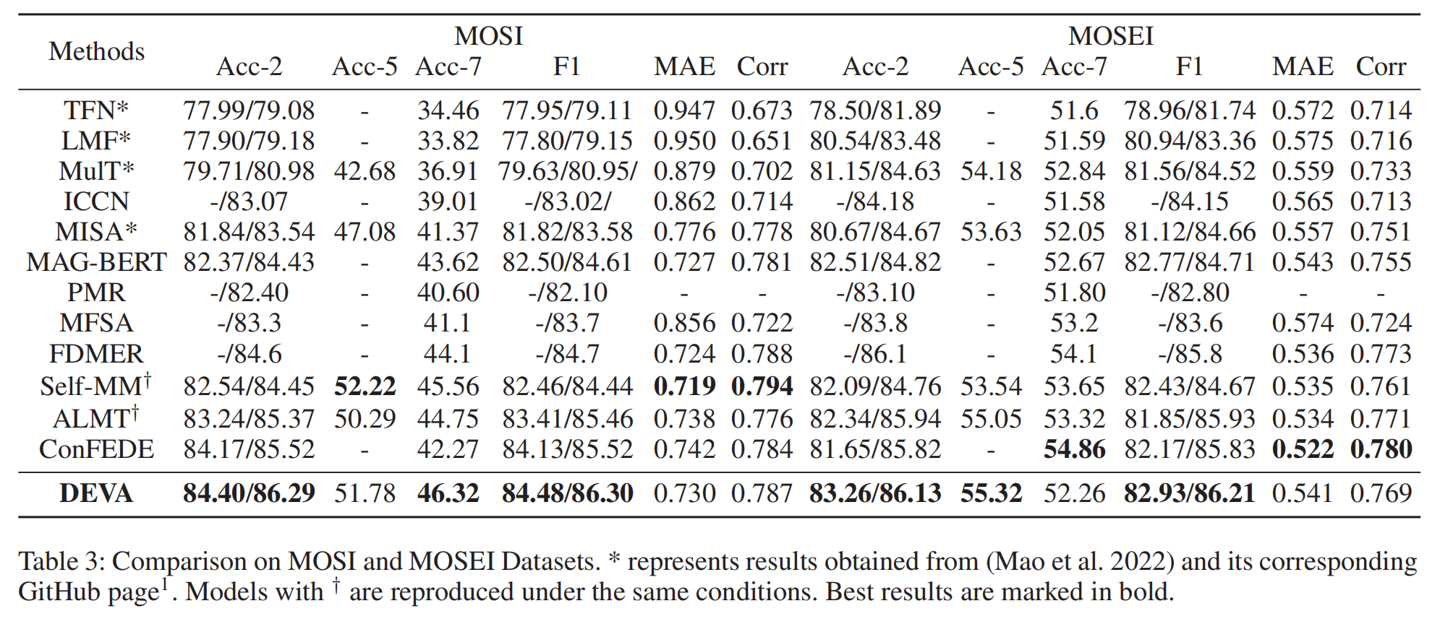
ATAI
AdvancedTechniqueof
Artificial Intelligence
ATAI
ChongqingUniversity _{AdvancedTechniqueof}
of Technology Artificial Intelligence
ChongqingUniversity of Technology
Experiments

Slide 9
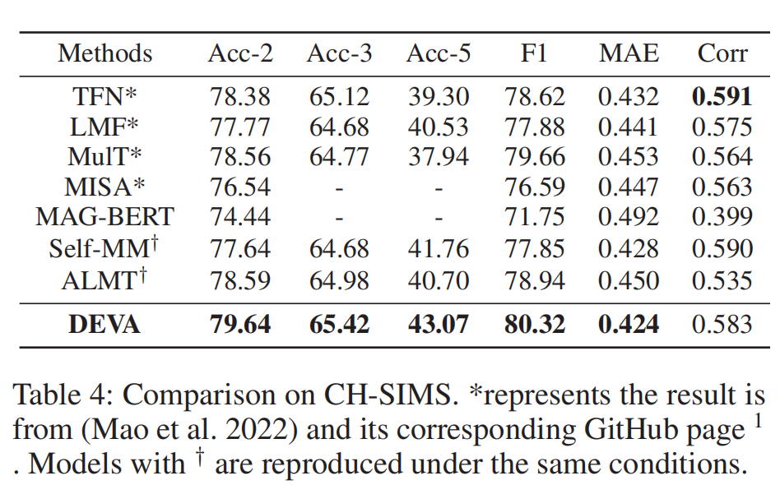
ATAI
AdvancedTechniqueof
Artificial Intelligence
ATAI
ChongqingUniversity _{AdvancedTechniqueof}
of Technology Artificial Intelligence
ChongqingUniversity of Technology
Experiments

Slide 10
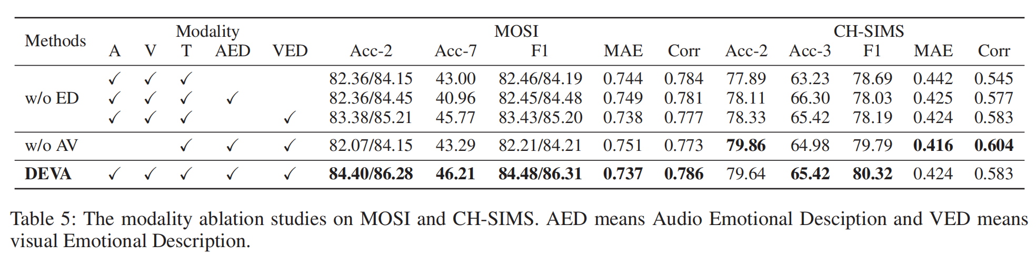
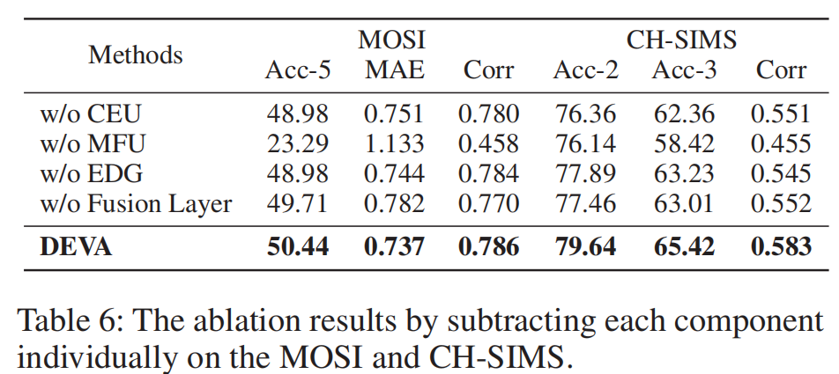
ChongqingUniversity of Technology
ATAI
AdvancedTechniqueof
Artificial Intelligence
ATAI
ChongqingUniversity _{AdvancedTechniqueof}
of Technology Artificial Intelligence
Experiments

Slide 11
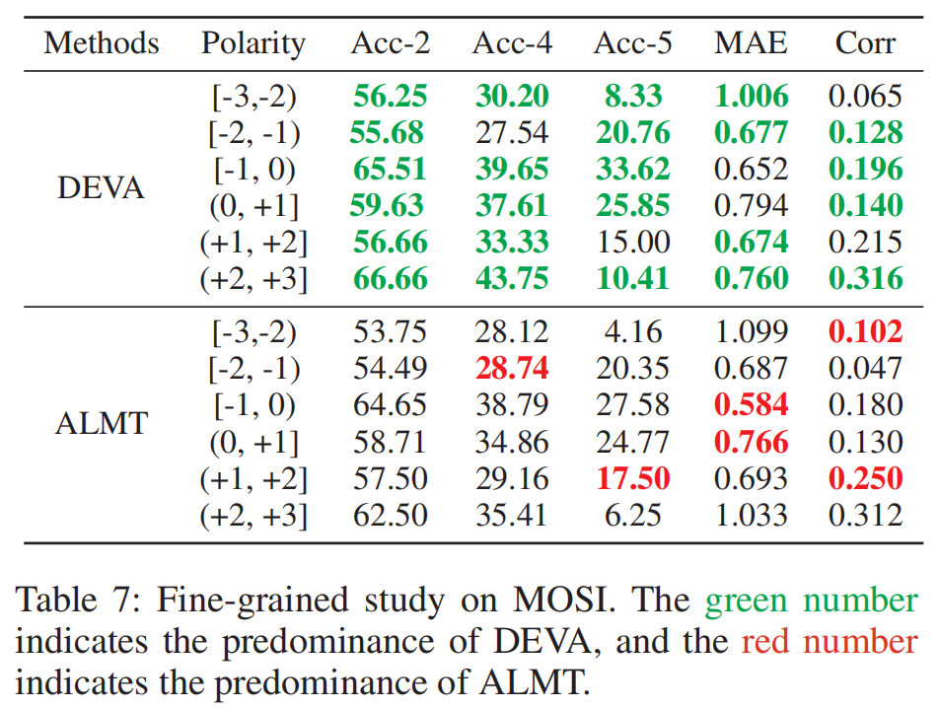
ChongqingUniversity of Technology
ATAI
AdvancedTechniqueof
Artificial Intelligence
ATAI
ChongqingUniversity _{AdvancedTechniqueof}
of Technology Artificial Intelligence
Experiments

Slide 12
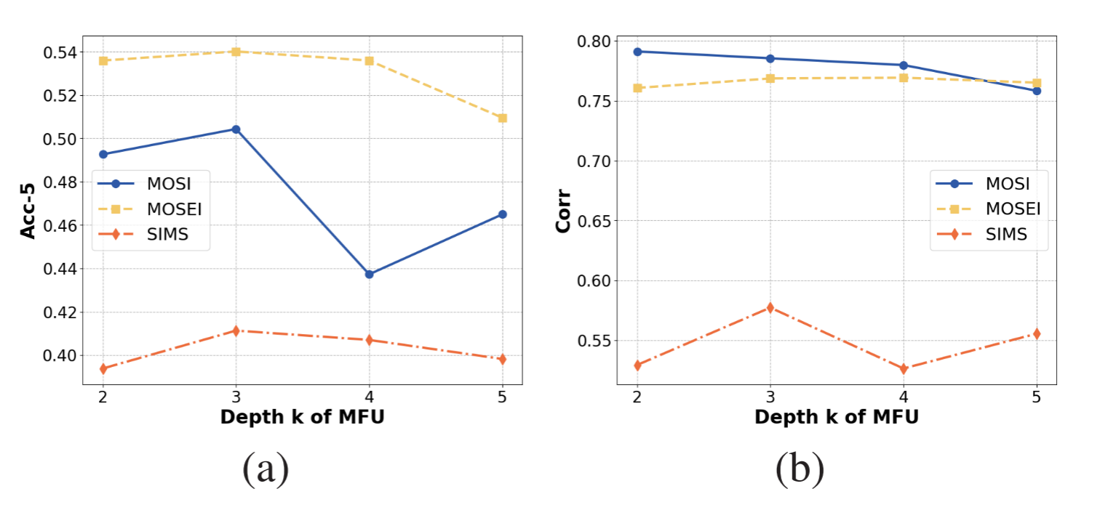
ChongqingUniversity of Technology
ATAI
AdvancedTechniqueof
Artificial Intelligence
ATAI
ChongqingUniversity _{AdvancedTechniqueof}
of Technology Artificial Intelligence
Experiments

Slide 13


ChongqingUniversity of Technology
ATAI
AdvancedTechniqueof
Artificial Intelligence
ATAI
ChongqingUniversity _{AdvancedTechniqueof}
of Technology Artificial Intelligence
Thanks!

